Slide 1
Data collection and data analysis of hematological results from Al Bukayriyah general hospital
Faris Abdul Hakim
161110206

Slide 2
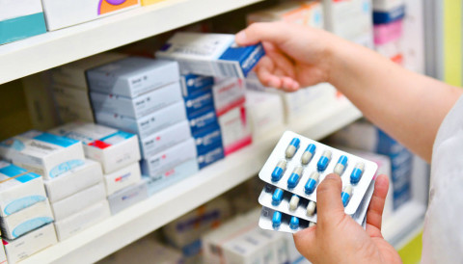


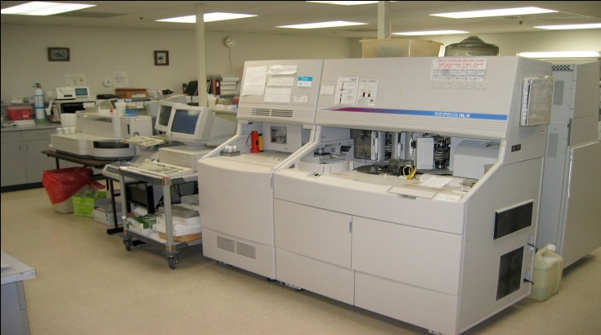
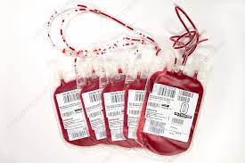
Abstract
Medical data is important to help physicians in making medical decision and to help hospital management make medical policy in the hospital.

Slide 3
Introduction
Goal : To have a clear picture of patients demographic data related to hematology of adult patients in Al Bukayriyah general hospital for the benefit of medical decision and policy.
Hematology department is one crucial department in the hospital. It provides various important tests in hematology field such as complete blood count and coagulation test.
Researcher focuses on complete blood count data

Slide 4
Literature review
Health-related data should be secure, accountable and transparent. (Vayena, 2018).
The case-based approach to decision making yielded more accurate recommendations (Malykh, 2018).
The policy that is made based on evidence data provides more effective healthcare (Vassiliou, 2020).
Data transparency from patients can help government to promote public health, patient safety and research (Wang, 2019).
CBC result can be the indicator of various diseases such as anemia, leukemia and bleeding disorder (Kawthalkar, 2020).

Slide 5
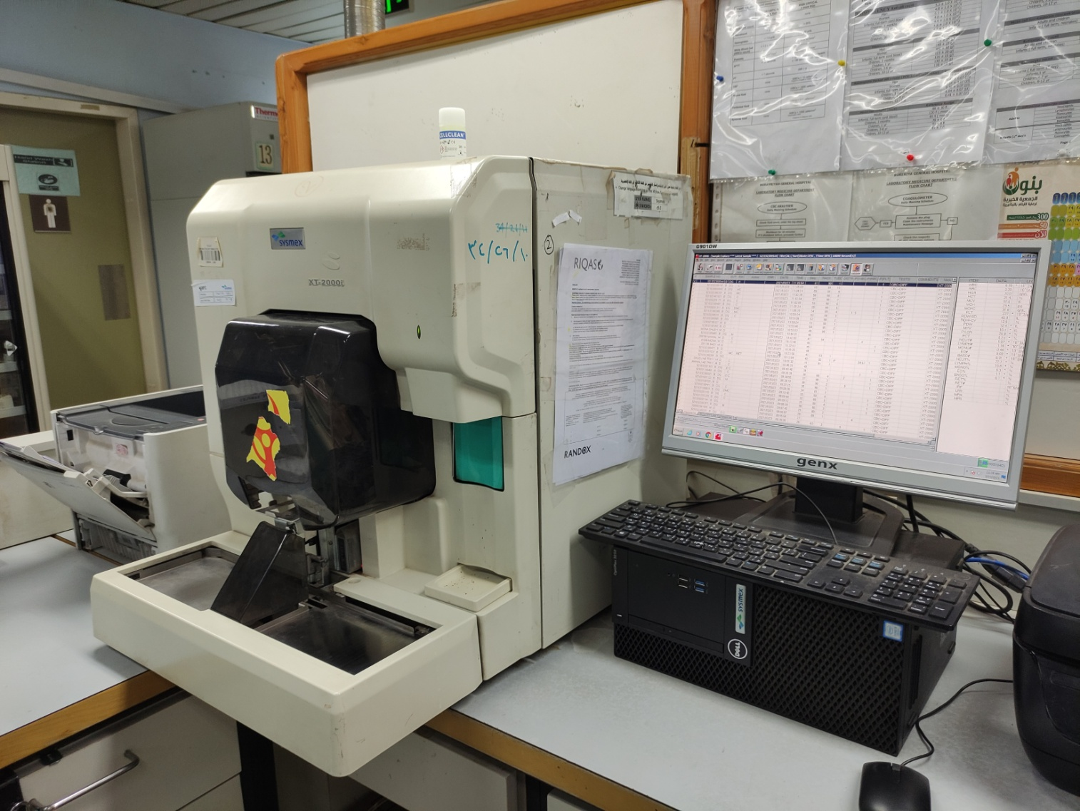
Material and method
Hematology analyzer XT-2000i.
Based on fluorescence flow cytometry.

Slide 6
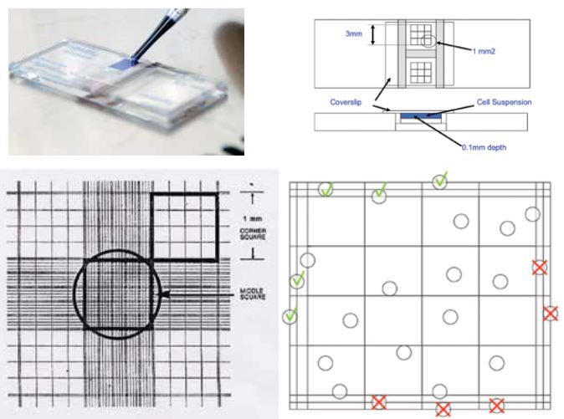
Hemocytometer
Notes:
For RBC, the dilution is 1:200 in saline solution.
For WBC, the dilution is 1:20 in glacial acetic acid to lyse RBC.
And stain with trypan blue.

Slide 7
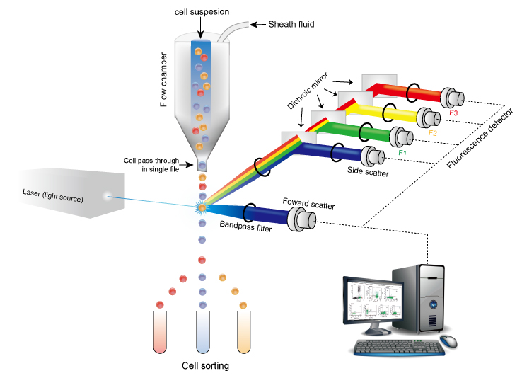
Fluorescence flow cytometry

Slide 8
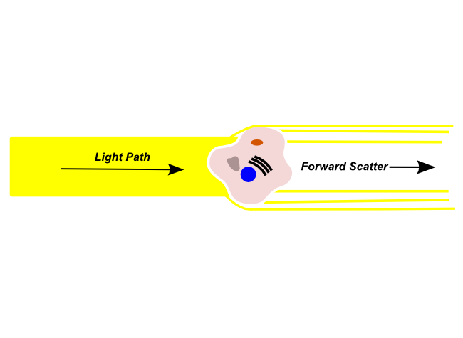
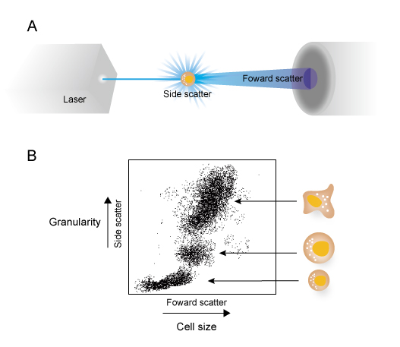
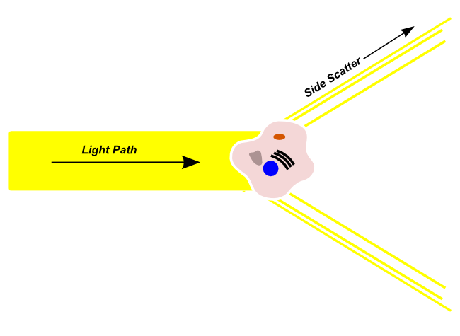
Forward-scattered light determines the size of the cell.
Larger cell will produce more forward scattered light.
Side-scattered light determines the granularity and complexity of the cell.
Highly complex and granulated cell will produce more side-scattered light.

Slide 9
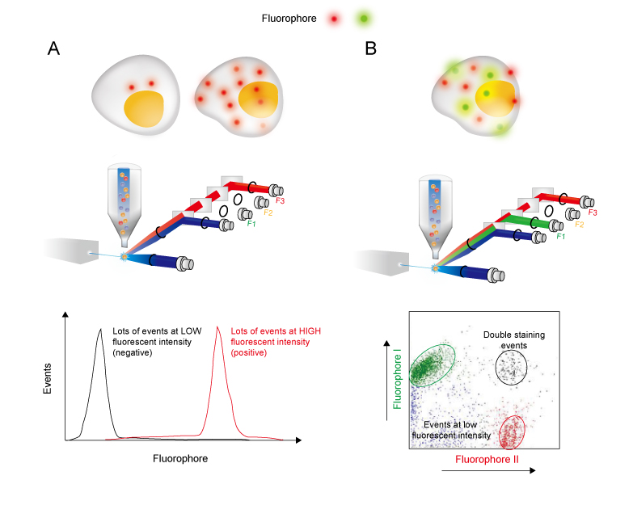
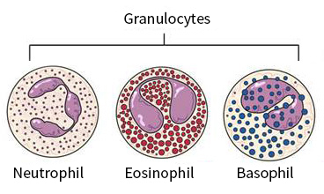
Fluorescence-labeled antibody marks the surface marker

Slide 10
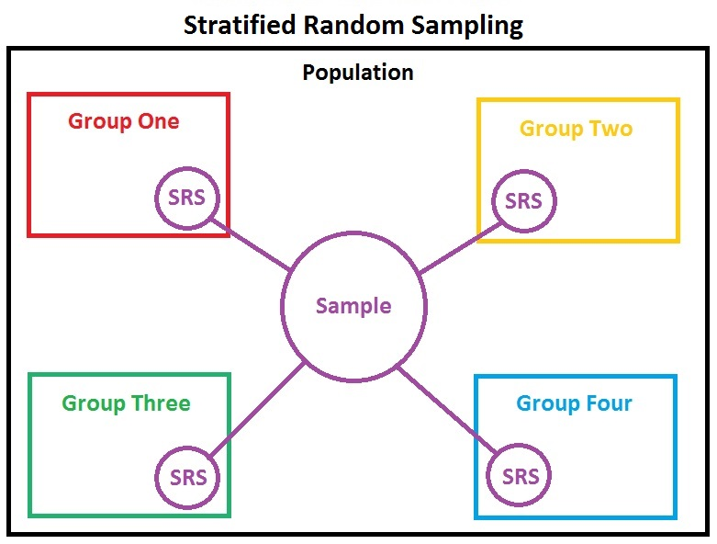
How the data was taken
Sampling method: stratified random sample (SRS).
100 adult patients’ data was collected from Al Bukayriyah general hospital.
The data was taken from 4 strata.
4 days results from 20th March 2021 to 23rd March 2021.
25 adult patients were selected randomly from each stratum.

Slide 11
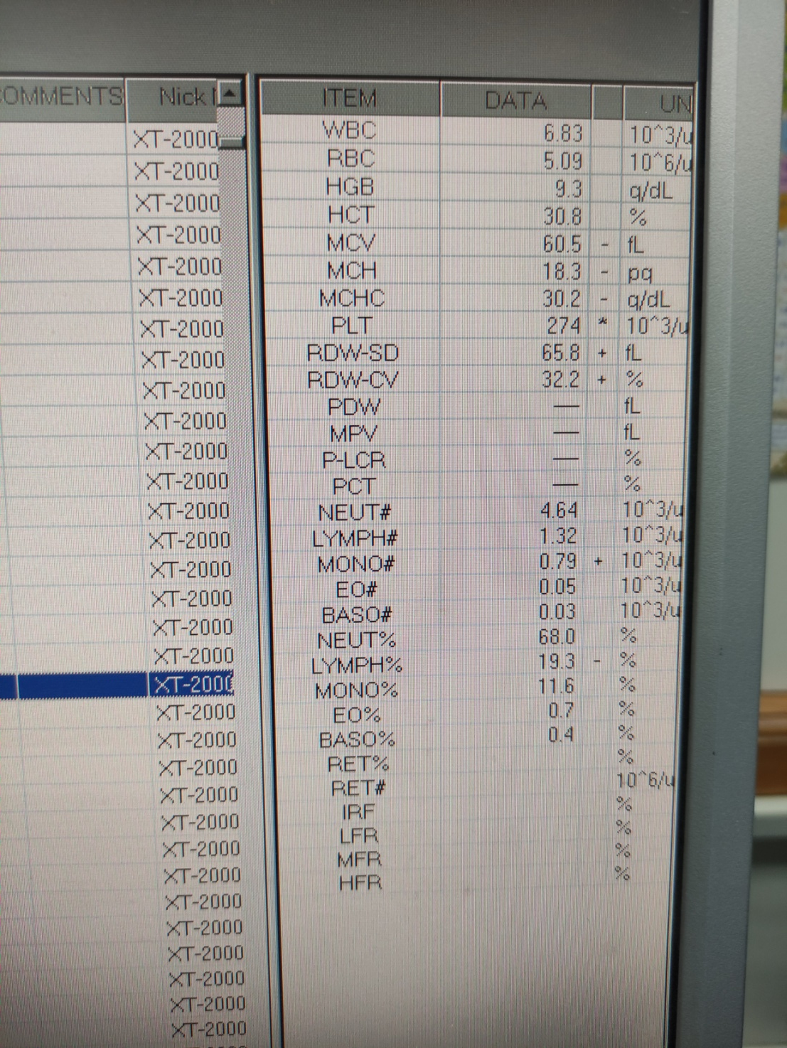
The data
What data can be analyzed ?
White blood cell count (WBC)
Red blood cell count (RBC)
Haemoglobin (HGB)
Haematocrit (HCT)
Mean cell volume (MCV)
Mean cell haemoglobin (MCH)
Mean cell haemoglobin concentration (MCHC)
Platelets (PLT) count

Slide 12
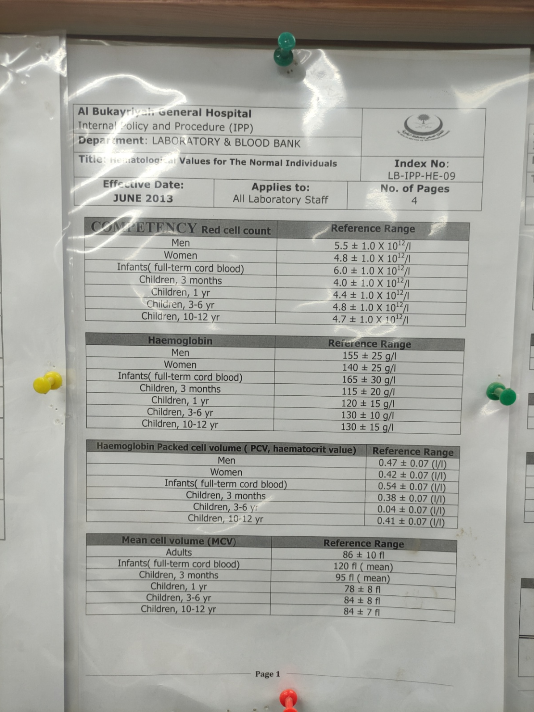
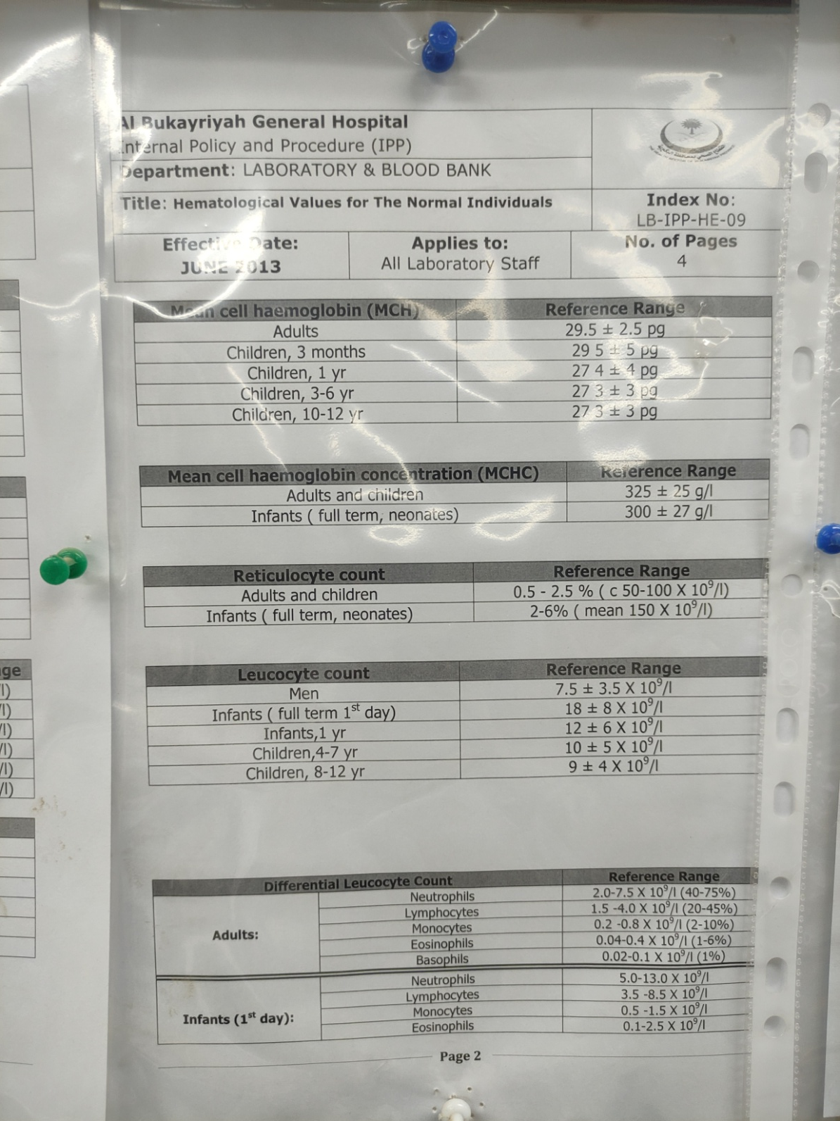

Slide 13
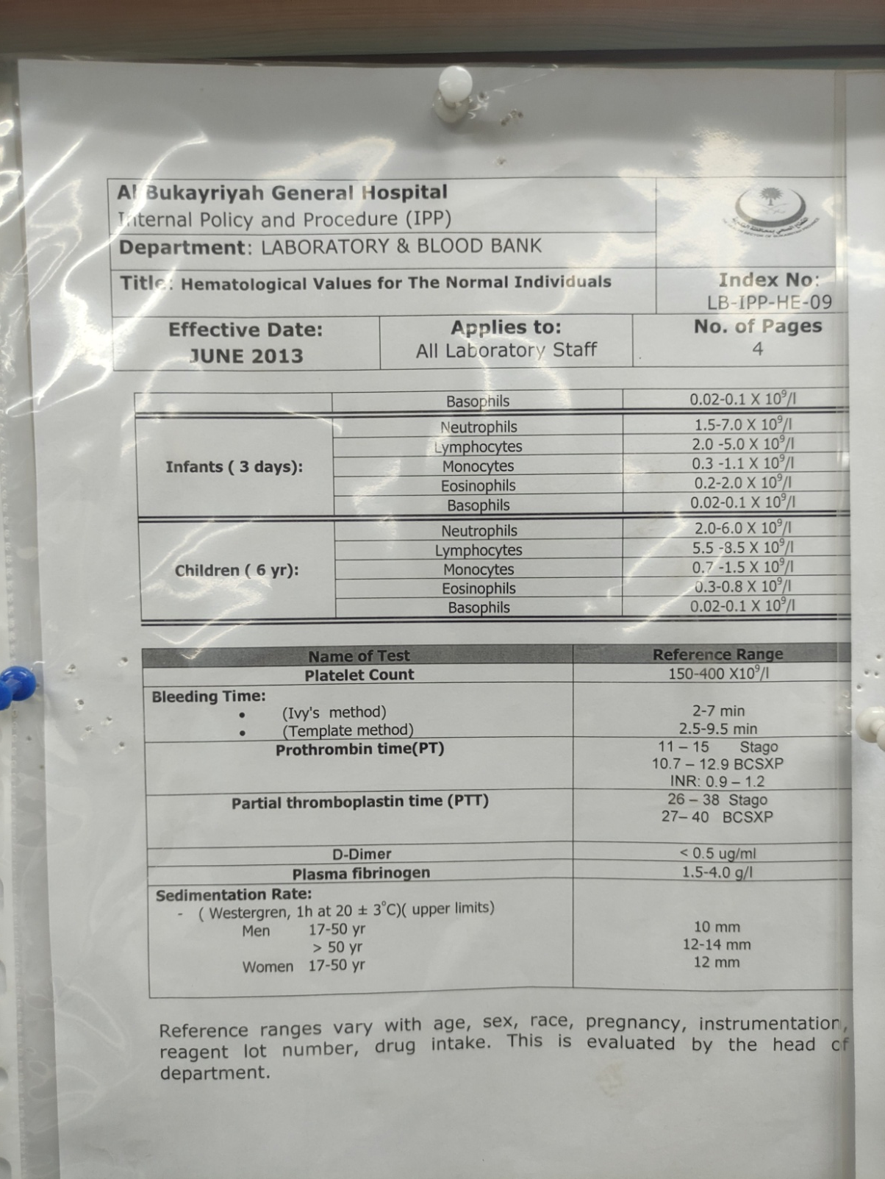
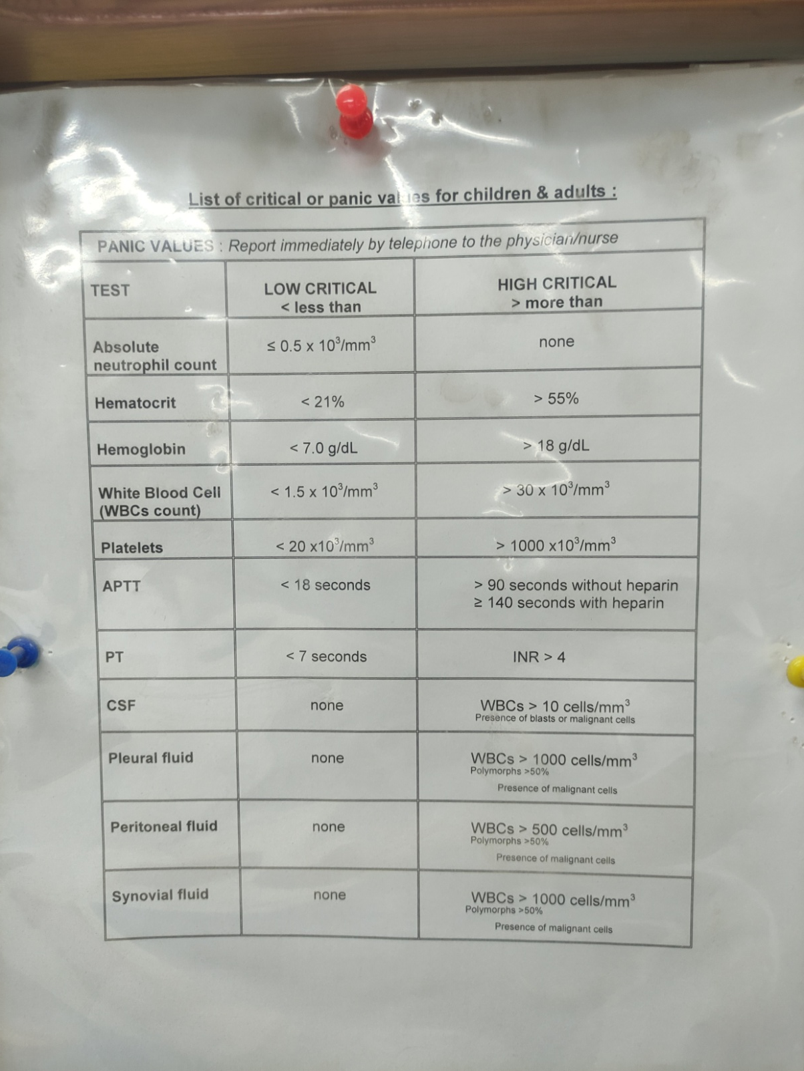

Slide 14
2 patients have HGB at critical value.
7 and 6.2 respectively.
Both patients have low HCT, MCV, MCH and MCHC.

Slide 15
Abnormalities data distribution
WBC
3
The most common abnormalities is PLT abnormality.
At around 50% of the total abnormalities.
1
1
PLT
5
HGB
2

Slide 16
HGB ABNORMAL RESULTS
Low MCV, MCH and MCHC
Low
non-critical
HGB
Low HCT
1
2
Low critical HGB

Slide 18
Result summary
Most of the patients who did the CBC test have normal results.
Critical value is quite rare at around 2% of the total results.
The most common critical value found is low critical HGB.
Low HGB always accompanied by other abnormalities such as low MCV, MCH and MCHC. With addition to low HCT in low critical HGB.
PLT abnormality is the most common abnormal result.
PLT abnormality usually doesn’t have other abnormalities.

Slide 19
Data analysis
Majority of patients with abnormal results have high PLT count with normal Platelet Distribution Width (PDW) which indicates reactive thrombocytosis which can be caused by inflammation or hemorrhage.
While all the critical value patients have low HGB 7.0 and 6.2 g/dL respectively. Both have low MCV, MCH and MCHC which indicates microcytic hypochromic anemia. Both also have high Red cell Distribution Width (RDW-CV) indicating iron deficiency anemia.

Slide 20
Discussion
Rokkam (2021) states, “Among individuals with thrombocytosis, 80% to 90% are known to have RT.” The higher number is observed at Al Bukayriyah general hospital with 100% of all thrombocytosis are RT.
Kitchens (2019) explains, “In one study of 280 patients with extreme thrombocytosis (platelet count of ≥1,000,000/μL), 82% were found to have secondary causes of thrombocytosis, and only 14% had MPNs that produced elevated platelet counts.” While in Al Bukayriyah general hospital from all the patients that have high PLT count, all of them are caused by RT and none of them caused by primary thrombocytosis.

Slide 21
Discussion cont.
A study confirmed a high prevalence of iron deficiency anemia (IDA) with low HGB in 4 regions in Saudi Arabia: Dammam, Makkah, Madina and Riyadh. With the result of 11.5%, 9.8%, 10.2% and 10.9% respectively (Owaidah, 2020). In comparison with the data from Al Bukayriyah general hospital at only 2%.
Another study conducted by Alswailem (2018) states, “683 females of Saudi nationality were enrolled in Riyadh Unit of Hematology - Department of Internal Medicine consented to participate in this research. Their ages ranged between 18 and 40 years, with a mode age between 31-40 years. The study population’s overall prevalence of IDA was found to be 41.6%.” This number is remarkably higher compared to our data from Al Bukayriyah general hospital which the prevalence of IDA is only 2%.

Slide 22
Reference
Kawthalkar SM. (2020) Essentials of Hematology. 3rd ed. New Delhi: Jaypee Brothers Medical Publishers.
Malykh VL, Rudetskiy SV. (2018) ‘Approaches to Medical Decision-Making Based on Big Clinical Data’. Hindawi, 2018, 10
Sousa MJ, Pesqueira AM, Lemos C, Sousa M, Rocha Á. (2019) ‘Decision-Making based on Big Data Analytics for People Management in Healthcare Organizations’. Journal of Medical System, 43, 290.
Melnykova N, Shakhovska N, Gregus M, Melnykov V, Zakharchuk M, Vovk O. (2020) ‘Data-Driven Analytics for Personalized Medical Decision Making’. Mathematics, 8, 1211.
Vogt-Schiavo K, Wolverton SE. (2021) Comprehensive Dermatologic Drug Therapy (Fourth Edition). 4th ed. Amsterdam: Elsevier.
Schwartz JS. (2017) Clinical and Translational Science (Second Edition). 2nd ed. Cambridge: Academic Press.
Müller H, Ünay D. (2018) ‘Medical Decision Support Using Increasingly Large Multimodal Data Sets‘. Big Data Analytics for Large-Scale Multimedia Search, 1, 14.
Dagliati A, Tibollo V, Sacchi L, Malovini A, Limongelli I, Gabetta M, Napolitan C, Mazzanti A, Cata PD, Chiovato L, Priori S, Bellazzi R. (2018) ‘Big Data as a Driver for Clinical Decision Support Systems: A Learning Health Systems Perspective’. Front Digit Humanit, 5, 8.
Capobianco E. (2019) ‘Data-driven clinical decision processes: it’s time’. J Transl Med, 17, 44.
Pickering BW, Gajic O, Ahmed A, Herasevich V, Keegan MT. (2013) ‘Data utilization for medical decision making at the time of patient admission to ICU’. Crit Care Med, 41(6), 1502-10.

Slide 23
Reference cont.
Brdarić D, Samardžić S, Huskić IM, Dritsakis G, Sessa J, Śliwińska-Kowalska M, Pawlaczyk-Łuszczyńska M, Basdekis I, Spanoudakis G. (2020) ‘A Data-informed Public Health Policy-Makers Platform’. International Journal of Environmental Research and Public Health, 17(9), 3271.
Vassiliou AG, Georgakopoulou C, Papageorgiou A, Georgakopoulos S, Goulas S, Paschalis T, Paterakis P, Gallos P, Kyriazis D, Plagianakos V. (2020) ‘Health in All Policy Making Utilizing Big Data’. Acta Inform Med, 28(1), 65-70.
Wang Z. (2019) ‘Data integration of electronic medical record under administrative decentralization of medical insurance and healthcare in China: a case study’. Isr J Health Policy Res, 8(1), 24.
Vayena E, Dzenowagis J, Brownstein JS, Sheikh A. (2018) ‘Policy implications of big data in the health sector’. Bull World Health Organ, 96(1), 66-68.
Alaskar A, Rehan H, Mendoza MA, Alsahan A, Immanuel A, Alhejazi A, Abuelgasim K, Salama H, Damlaj M, Gmati G, Alzahrani M, Rather M, Alahmari B, Mugairi AA, Ahmed A. (2019) ‘Hematological Profile in the Saudi Population: Reference Intervals By Gender, Age and Regions’. Blood, 134, 5804.
Wang MC, Huang CE, Lin MH, Yang YH, Lu CH, Chen PT, Wu YY, Tsou HY, Hsu CC, Chen CC. (2018) ‘Impacts of demographic and laboratory parameters on key hematological indices in an adult population of southern Taiwan: A cohort study’. PLOS ONE, 13(8), 0201708.
Siraj N, Issac J, Anwar M, Mehari Y, Russom S, Kahsay S, Frezghi H. (2018) ‘Establishment of hematological reference intervals for healthy adults in Asmara’. BMC Res Notes, 11(1), 55.
Bain B, Bates I, Laffan M. (2017) Dacie and Lewis Practical Haematology. 12th ed. Philadelphia: Elsevier.
Hoffman R, Benz EJ, Silberstein LE, Heslop HE, Weitz JI, Anastasi J, Salama ME, Abutalib SA. (2018) Hematology Basic Principles and Practice. 7th ed. Philadelphia: Elsevier.
Rodak B, Carr J. (2016) Clinical Hematology Atlas. 5th ed. Philadelphia: Elsevier.

Slide 24
Reference cont.
Rokkam VR, Kotagiri R. (2020) Secondary Thrombocytosis. In: StatPearls [Internet]. Treasure Island (FL): StatPearls Publishing.
Kitchens CS, Kessler CM, Konkle BA, Streiff, MB, Garcia DA. (2019) Consultative hemostasis and thrombosis. Philadelphia, PA: Elsevier.
Owaidah T, Al-Numair N, Al-Suliman A, Zolaly M, Hasanato R, Zahrani FA, Albalawi M, Bashawri L, Siddiqui K, Alalaf F, Almomen A, Sajid MR. (2020) ‘Iron Deficiency and Iron Deficiency Anemia Are Common Epidemiological Conditions in Saudi Arabia: Report of the National Epidemiological Survey’. Anemia, 2020, 8.
Alswailem A, Alahmad S, Alshehri M. (2018). ‘The Prevalence of Iron Deficiency Anemia and its Associated Risk Factors among a Sample of Females in Riyadh, Saudi Arabia’. The Egyptian Journal of Hospital Medicine, 72(6), 4625-29.

Slide 25
Thank you

